Slide 1
COIT12207 Internet Applications
Week 1 Introduction to Internet Applications

Slide 2
Outline
Term House Keeping
Internet Applications
Web Application Architectures
How Web Application Architecture Works
Front-end and back-end web development
HTML5 and CSS Review
HTML5 Web Forms
HTML5 Events

Slide 3
House Keeping
Three main sections
HTML5 / JavaScript (Week 1 – Week 2)
BootStrap5 / HTML5/ jQuery (Week 3 – Week 6)
PHP and MySQL (Week 7 – Week 12)
Three assignments
Online Survey to support social innovation (due Week 3)
Mobile friendly online business (due Week 7)
Database-driven business (due Week 13)
Pass criteria: 40% Assignment 3 & 50%+ overall

Slide 4
House Keeping (cont.)
Delivery mode – workshops
Shorter lecture slides + more hands-on exercises
Questions for review
Project Shell - a template provided
Source Files - solutions for hands-on projects
Online forum
Moodle website

Slide 5
Internet Applications
An Internet application is a client/server application that uses standard Internet protocols for connecting the client to the server.
Examples:
Social media
Sending and receiving email
Mobile apps
Multiplayer online games
Streaming media services
Navigating
Banking
etc.
Can be web-based (public, on WWW) or Intranet (within an origination)

Slide 6

Two main paradigms (1)
Client-Server
Client: application (not the machine) that actively initiates contact. Generally runs on end users’ devices.
Server: the application (not the machine) that passively waits for contact. Generally reside on big machines and can serve many clients simultaneously. Servers often have fixed, permanent IP addresses. They don’t know in advance who the clients are.
A server should be: multithreaded, fork copies of itself & event-driven
Client-Server examples: Most web applications, heaps

Slide 7
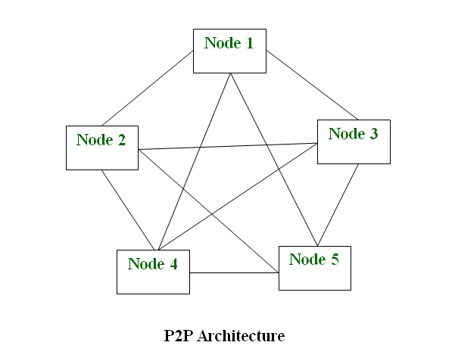
Two main paradigms (2)
Peer to Peer (P2P)
Client = Server
Advantages:
Network is easy to maintain because each node is independent of each other.
Since each node acts as a server, therefore the cost of the central server is saved.
Adding, deleting and repairing nodes in this network is easy.
Disadvantages of P2P Network :
Because of no central server, data is always vulnerable to get lost because of no backup.
It becomes difficult to secure the complete network because each node is independent.
Some P2P examples: Bluetooth, Skype, Napster

Slide 8
Web Application Architecture
A Web Application is a computer application working over the Internet; it is delivered on the WWW and runs in a web browser.
Web application architecture describes the interactions between applications, components, databases, middleware systems, user interfaces, and servers in an application.
It can also be described as the layout that logically defines the connection between the server and client-side for a better web experience.
It is important because it affects efficiency, scalability, reliability, security, applicability and robustness of internet communications

Slide 9
Service Oriented Architecture (SOA)
To support service orientation, an enterprise-wide approach
A service has 4 properties:
Logically represents a repeatable business activity with a specified outcome
Self-contained
It is a black box for its consumers, meaning the consumer doesn’t have to be aware of the service’s inner workings
May be composed of other services
Examples: Dropbox, Google workspace, Google docs..
Benefits
Code reuse
Promote interaction
Scalability

Slide 10
Microservices Architecture
Is an architectural style that structures an application as a collection of services that are
Highly maintainable and testable
Loosely coupled
Independently deployable
Organized around business capabilities
Owned by a small team
Small independent services that communicate over well –defined APIs.
Examples: PayPal, Uber,

Slide 11
SOA and Microservices
Commonalities
Both involve cloud or hybrid cloud
Both can scale to meet the speed and operational demands of big data
Differences:
SOA has an enterprise scope, provide infrastructure services, application services, functional services…
Microservices has an application scope.
SOA communicate by XML data
Microservices communicate via API

Slide 12
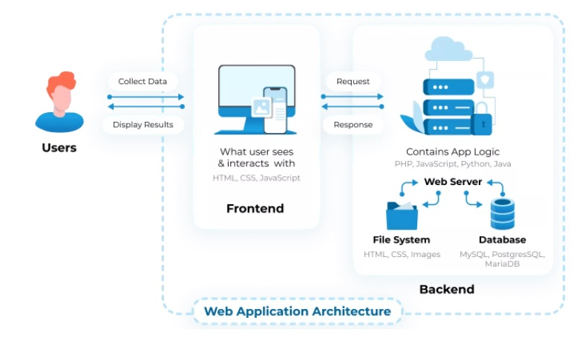
2 or 3-Tier Web Application Architecture
A typical 3-tier web application
Presentation tier (frontend)
Application tier (backend)
Database tier (backend)
COIT12207 focused
Source: https://litslink.com/blog/web-application-architecture

Slide 13
How a Web Application work
Two different code (sub-programs) running side-by-side:
Front-end (Client–side) Code:
The code that is in the browser and responds to some user input
A combination of CSS, HTML and JavaScript
Code is visible by user
Back-end (Server–side) Code:
The code that is on the server and responds to the HTTP request
Communicate only via HTTP request
Code is not visible
PHP, JSF, ASP, Python, MySQL
This unit covers: CSS, HTML5, JavaScript, PHP, MySQL and related topics

Slide 14
CSS and HTML5 revision
CSS is used to style an HTML document
CSS describe how HTML element should be displayed (font, size, color, etc.)
CSS can be used in 3 ways
Inline – by using style attribute inside HTML elements
Internal – by using <style> element in the <head> section
External – by using a <link> element to link to an external CSS file
HTML is the standard markup language for web pages; It describes the structure of a web page; It consists of a series of elements; It’s elements tell the browser how to display the content
HTML5 is the latest and most enhanced version of HTML.
You have learned CSS topic and some basic HTML topics in prerequisite unit.

Slide 15
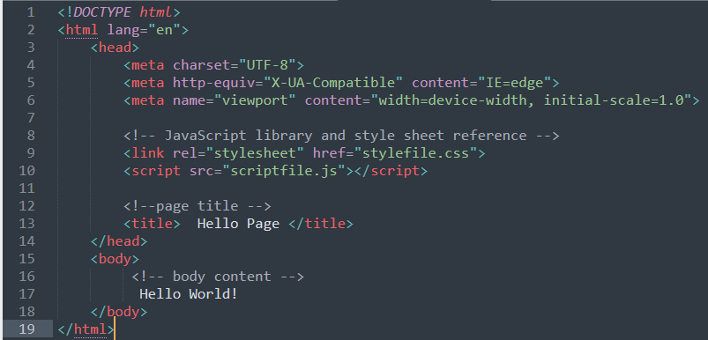
HTML5 – STRUCTURE
<!DOCTYPE html>
<meta>
- browser compatibility, responsive
<link>
<script>

Slide 16
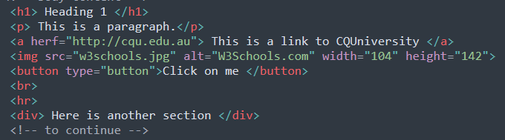
HTML5 – ELEMENTS (i.e. tags)
HTML tag names: insensitive
Most tags are paired: <p>…</p>
Some tags only have start tags:
e.g. <img>, <hr>, <br>
HTML5 Tags: https://www.tutorialspoint.com/html5/html5_tags.htm#

Slide 17
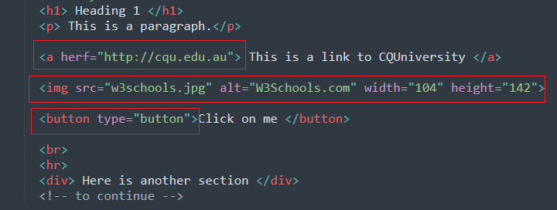
HTML5 - ATTRIBUTES
All HTML elements can have attributes
Attributes provide additional information about elements
Attributes are always specified in the start tag
Attributes usually come in name/value pairs like: name="value"
HTML attribute list: https://www.tutorialspoint.com/html5/html5_attributes.htm

Slide 18
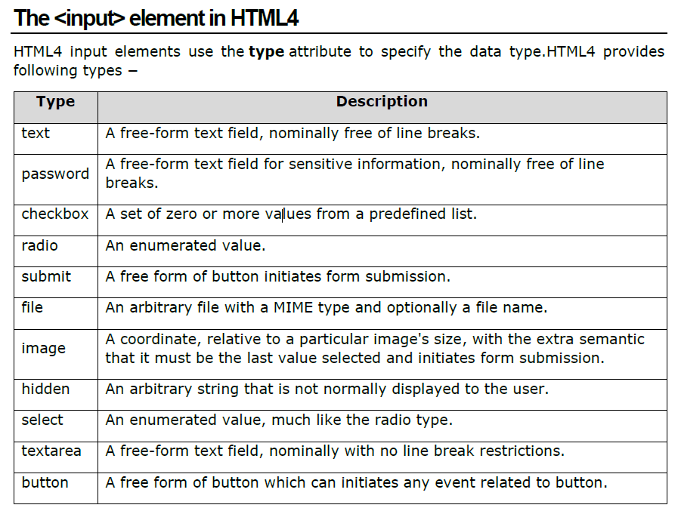
WEB FORMS (HTML4)

Slide 19
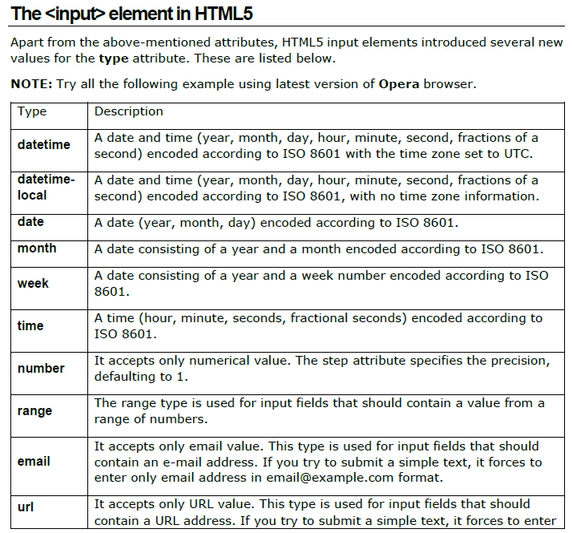
WEB FORMS (HTML5)

Slide 20
HTML5 – EVENTS
When users visit your website, they perform various activities such as clicking on text and images and links, hover over defined elements, etc. These are examples of what JavaScript calls events.
Event handlers can be implemented in JavaScript
JavaScript is to program the behaviour of web pages.
Commonly used web events:
onsubmit - Triggers when a form is submitted
onclick - Triggers on a mouse click
onmouseover - Triggers when the mouse pointer moves

Slide 21
HTML5 – Form Validation
Required - mandatory input
Maxlength – specify the maximum number of characters
Minlength – specify the minimum number of characters
Min and Max – specify the minimum and maximum allowed values (e.g. range, date, week, age)
Multiple – allow user to enter multiple values (only for ‘email’ and ‘file’ input type)
Pattern – define a particular pattern for an input field. Useful for date, URL, phone, email and password types.
Input form validation can be done by HTML attributes (abovementioned) and JavaScript (next week)

Slide 22
Hands-on Projects
Hands-on Project 1
Create an online survey form using HTML5 and CSS
Hands-on Project 2
Input form validation using HTML5
Hands-on Project 3
Social Innovation topic investigation and identification

Slide 23
References
https://hackr.io/blog/web-application-architecture-definition-models-types-and-more
https://www.peerbits.com/blog/web-application-architecture.html
https://en.wikipedia.org/wiki/Service-oriented_architecture#Event-driven_architectures
https://www.tutorialspoint.com/html5/html5_tutorial.pdf

